Slide 1
Java Programming Language
Lecture #02. Intro to Java

Slide 2
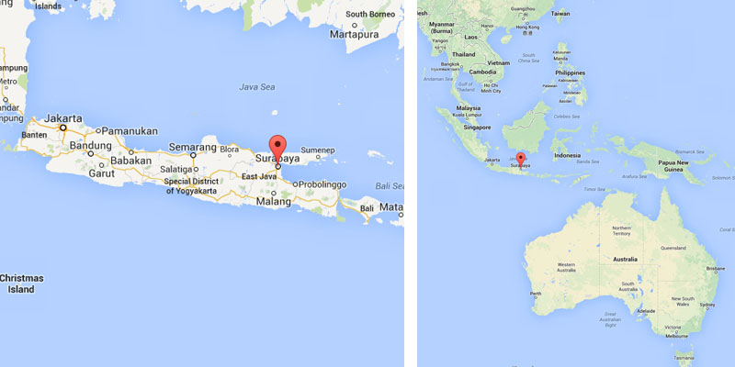
Island and Sea (Indonesia)

Slide 3

Java Man

Slide 4
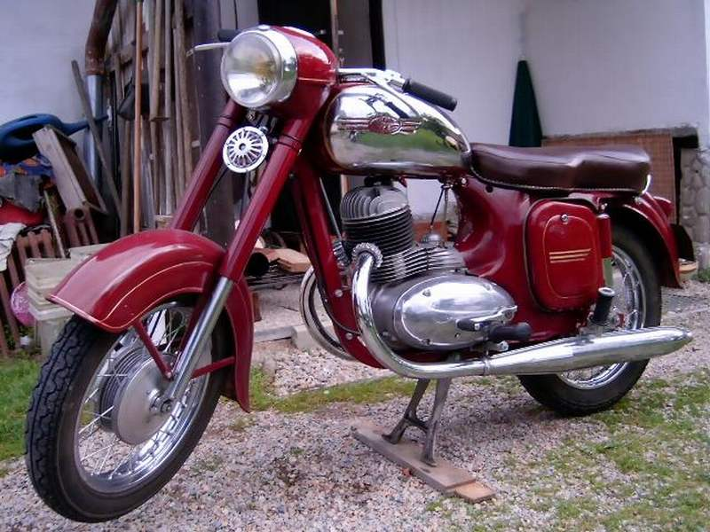
Bike
(Jawa, Czechoslovakia
& India)

Slide 5

Cigarettes (USSR)

Slide 6

Coffee (Indonesia)

Slide 7

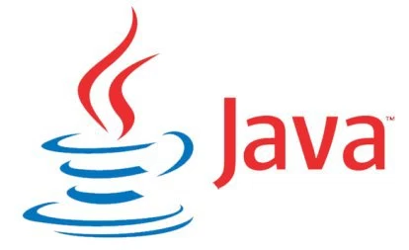
Programming Language (Sun)
Duke

Slide 8
History
Release date:
January 23, 1995 (Oak)
Initial purpose:
embed language for home appliance
Version 1.0:
August 26, 1996 (Java)
Current purpose:
develop client and server applications

Slide 9
Language Features
Syntax close to C/C++
Automatic garbage collection
Strong static typing

Slide 10
Language Features
Compiled to byte-code
Interfaces
Reflection

Slide 11
Platform Features
JVM – “write once, run anywhere”
  Java Virtual Machine
JIT – (inspired by Lisp and Smalltalk)
  Just-In-Time compilation

Slide 12
Platform Features
Monitor runtime (JConsole, JProfiler, VisualVM, ...)
Cross-platform: Linux, Windows, ...
JVM-base languages: Scala, Kotlin, Clojure, ...
IDEs: Intellij IDEA, NetBeans, Eclipse, ...

Slide 13
Platform Features
Tons of libraries (Apache Software Foundation, ...)
Repositories of libraries (Maven Central, ...)
Universal frameworks for server applications (Spring, ...)

Slide 14
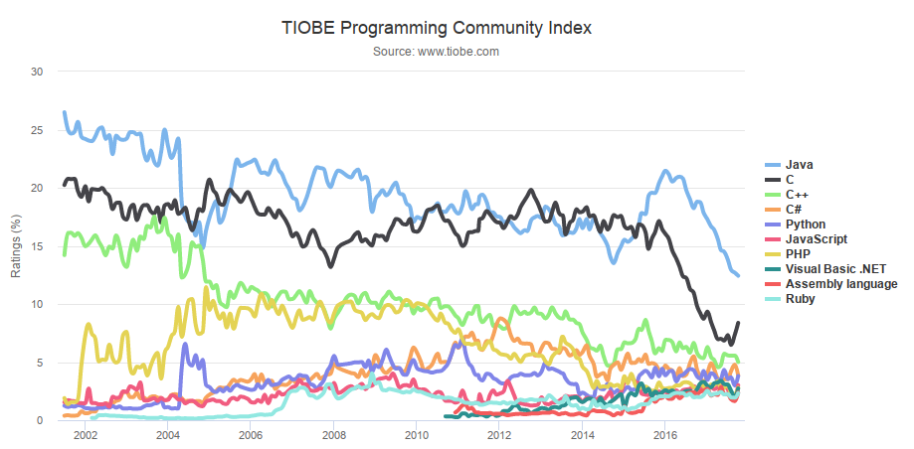
Popularity

Slide 15
Usage
Sensitive data: finance, medicine, …
Server side (backend)
DBMS — Cassandra, Hadoop, Neo4j, …
Smart cards and other micro devices
Android and other mobile platforms

Slide 16
Java Distributions
JRE — runtime only
  Java Runtime Environment
JDK — compiler and tools
  Java Development Kit
Java SE
  Standard Edition
Java EE — libraries
  Enterprise Edition

Slide 17
Java Distributions
OpenJDK
  reference implementation of Java SE since version 7
Oracle JDK
IcedTea
some others

Slide 18
Java Versions
J2SE 1.2, 1998, Collections framework
J2SE 1.4, 2002, Non-blocking IO (NIO)
J2SE 5.0, 2004, Generics, annotations
Java SE 7, 2011, invokedynamic
Java SE 8, 2014, lambdas, Date and Time API, JavaFX
Java SE 9, 2017, Project Jigsaw, jshell

Slide 19
Installation
# if no OpenJDK in your repo (Ubuntu 14.04, Mint 17)
sudo add-apt-repository ppa:openjdk-r/ppa
sudo apt update
sudo apt install openjdk-8-jdk
# if you have more than one JDK installed
update-alternatives --config java
update-alternatives --config javac

Slide 20
HelloWorld
File HelloWorld.java
public class HelloWorld {
public static void main(String[] args) {
// Prints "Hello, World" to the terminal window.
System.out.println("Hello, World");
}
}

Slide 21
Command Line Tools
javac HelloWorld.java
creates HelloWorld.class
java HelloWorld

Slide 22
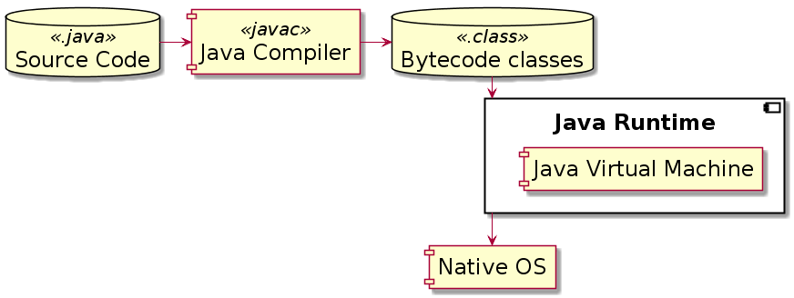
Compilation and Run

Slide 23
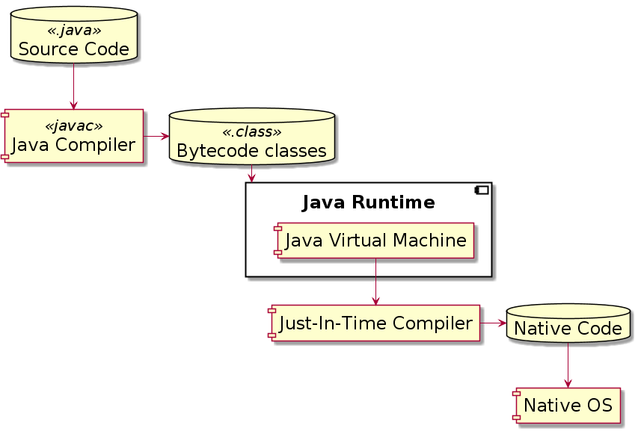
Compilation and Run

Slide 24
IntelliJ IDEA
Java IDE from JetBrains (St. Petersburg)
Community Edition
Ultimate Edition

Slide 25
Homework
Install
  Linux Mint 18.2 64-bit (Cinnamon)
  OpenJDK 8 (JDK)
  IntelliJ IDEA 2017.2 Community Edition
HelloWorld
  write
  compile in console
  run in console

Slide 26
Questions and Homework
To: teachers@7bits.it
Subject: Java Homework #1

